Slide 1
Lab 11 and 12: MOSFETs
EE316-08 Spring 2021

Slide 2
Purpose: The concept and characteristics of Metal Oxide Semiconductor Field Effect Transistors (MOSFETs) are introduced. Both N-channel and P-channel MOSFETs will be considered.

Slide 3
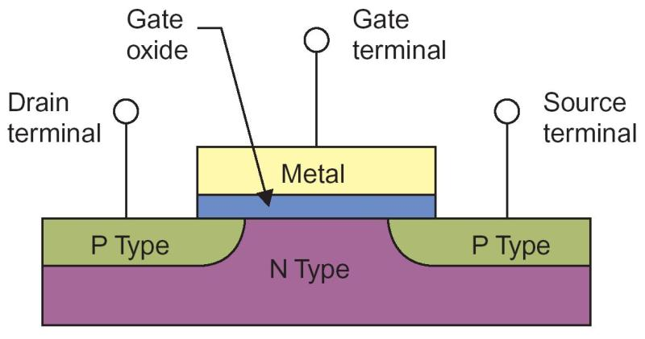
Background
Metal Oxide Semiconductor Field Effect Transistor (MOSFET) is the most common type of insulated gate FET that designed for switching or amplifying voltages in the circuits.
In other word, MOSFET is a voltage-controlled field effect transistor.
Structural diagram of N-channel MOSFET
MOSFET has a metal oxide gate electrode which is electrically insulated from the main semiconductor N-channel or P-channel by a thin layer of insulating material.
Therefore, the gate terminal is isolated from the main current carrying channel, and no current flows into the gate.

Slide 4
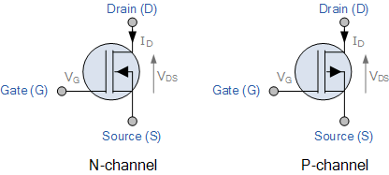
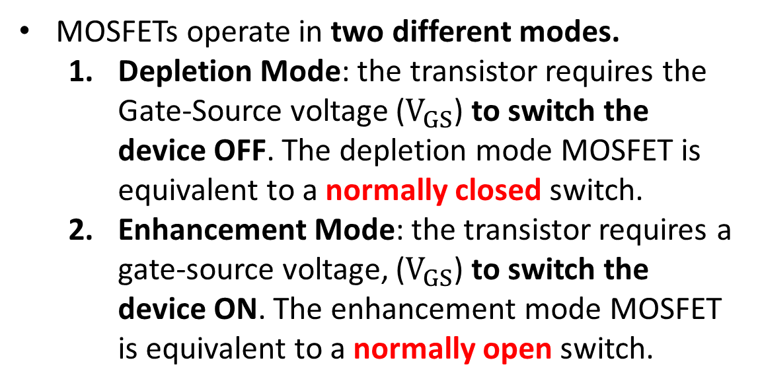
Background
MOSFETs are three terminal devices with a Gate, Drain, and Source.
The current flowing through the main channel between the drain and source is proportional to the input voltage.
MOSFETs can be made extremely small, can draw very little input current, and consume small power.
MOSFETs operate in two different modes.
Depletion Mode: the transistor requires the Gate-Source voltage ($V_{GS}$) to switch the device OFF. The depletion mode MOSFET is equivalent to a normally closed switch.
Enhancement Mode: the transistor requires a gate-source voltage, ($V_{GS}$) to switch the device ON. The enhancement mode MOSFET is equivalent to a normally open switch.
Symbolic representation of MOSFETs Under the Depletion Mode

Slide 5
Structural Diagram of MOSFETs
Two P-type semiconductors fixed at Drain and Source terminals in the channel region.
The channel between Drain and Source is N-type.
Two N-type semiconductors fixed at Drain and Source terminals in the channel region.
The channel between Drain and Source is P-type.
P
P
N
N
N
P
Substrate
Substrate
N-channel MOSFET
P-channel MOSFET

Slide 6
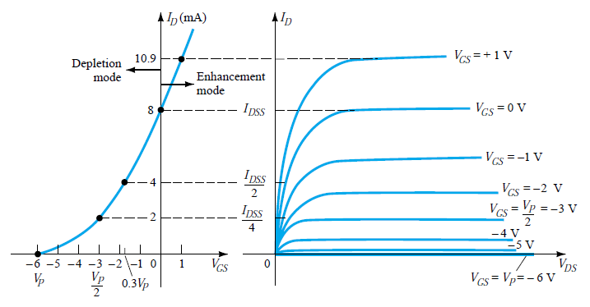
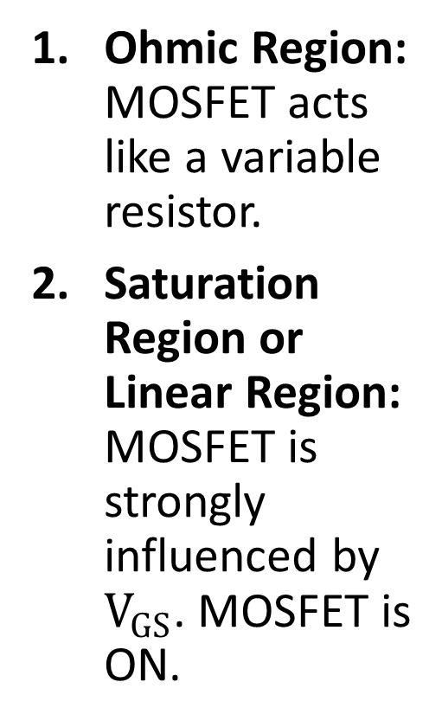
Depletion Mode N-Channel MOSFET
Ohmic Region: MOSFET acts like a variable resistor.
Saturation Region or Linear Region: MOSFET is strongly influenced by $V_{GS}$. MOSFET is ON.
1. Ohmic
2. Saturation Region

Slide 7
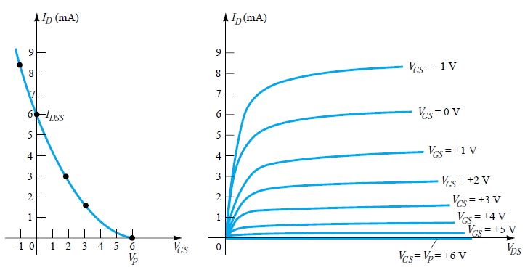
Depletion Mode P-Channel MOSFET

Slide 8
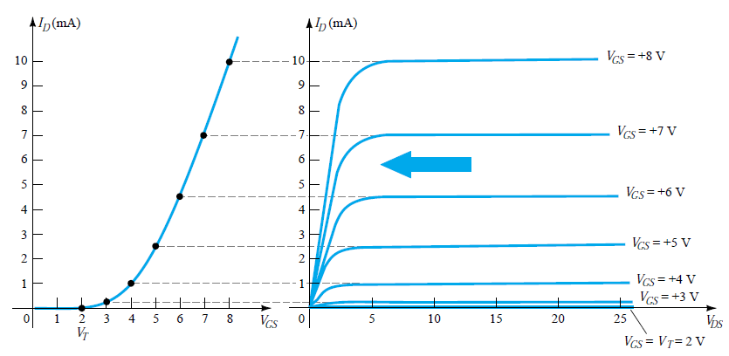
Enhancement Mode N-Channel MOSFET
1. Ohmic
2. Saturation Region

Slide 9
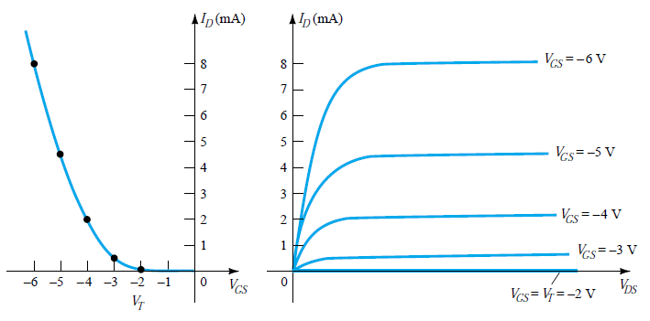
Enhancement Mode P-Channel MOSFET

Slide 10
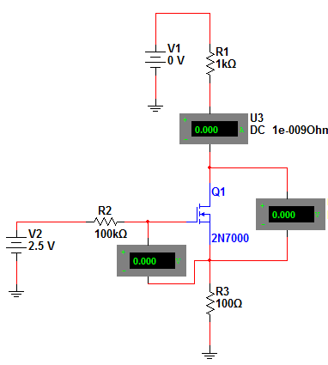






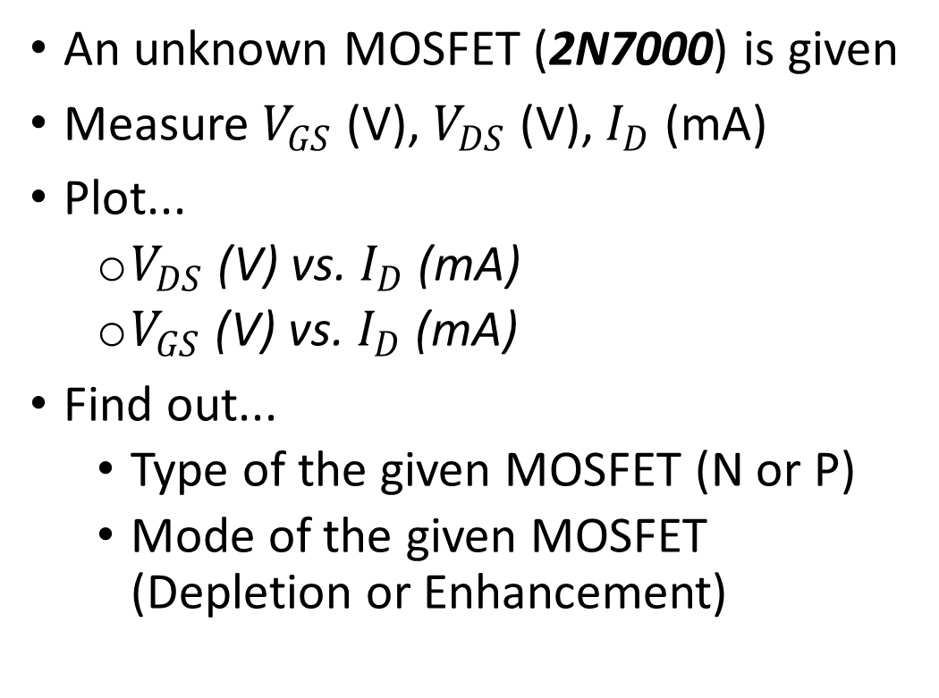
Figure 11.5: Main Idea
An unknown MOSFET (2N7000) is given
Measure $V_{GS}$ (V), $V_{DS}$ (V), $I_{D}$ (mA)
Plot...
$V_{DS}$ (V) vs. $I_{D}$ (mA)
$V_{GS}$ (V) vs. $I_{D}$ (mA)
Find out...
Type of the given MOSFET (N or P)
Mode of the given MOSFET (Depletion or Enhancement)
$$I_{D}$$
$$V_{D}$$
$$V_{G}$$
Drain
$$V_{DS}$$
Gate
Source
$$V_{GS}$$
$$V_{S}$$
Note: This is just the main point for lab 11. There will be sub-questions such as identify threshold voltage, and the minimum $V_{DS}$ values. Please make sure you answer all questions in the lab manual.

Slide 11
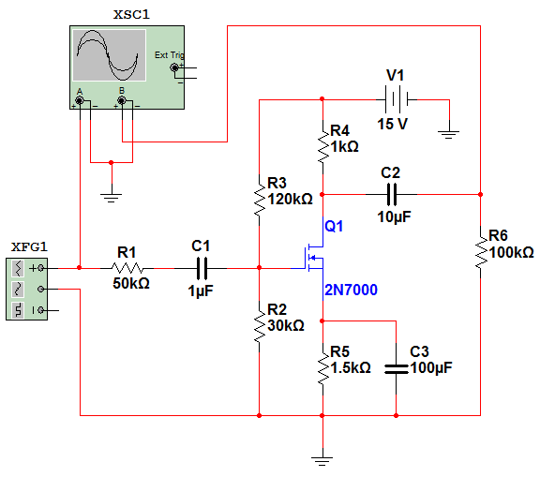
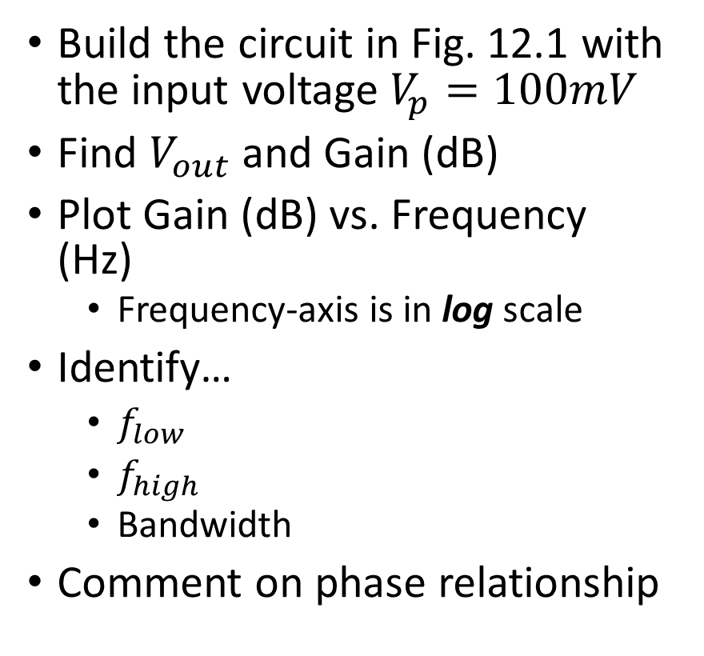
Figure 12.1
Build the circuit in Fig. 12.1 with the input voltage $V_{p}=100mV$
Find $V_{out}$and Gain (dB)
Plot Gain (dB) vs. Frequency (Hz)
Frequency-axis is in log scale
Identify…
$f_{low}$
$f_{high}$
Bandwidth
Comment on phase relationship

Slide 12
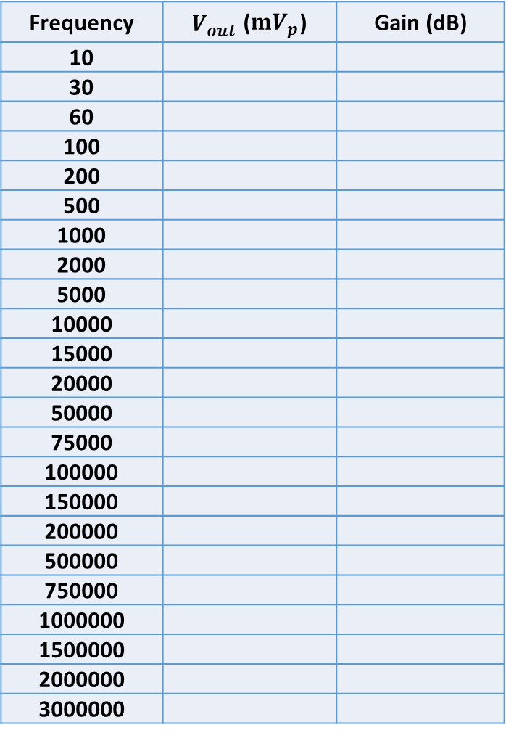



Gain, Low and High Cutoff Frequencies, and Bandwidth
Frequency | $V_{out}$ ($mV_{p}$) | Gain (dB)
10
30
60
100
200
500
1000
2000
5000
10000
15000
20000
50000
75000
100000
150000
200000
500000
750000
1000000
1500000
2000000
3000000
19
3 dB
16
Bandwidth
7
4
$f_{L}$~ 10 Hz
$f_{H}$~ 10M
Therefore, Bandwidth = $f_{H}$- $f_{L}$

Slide 13

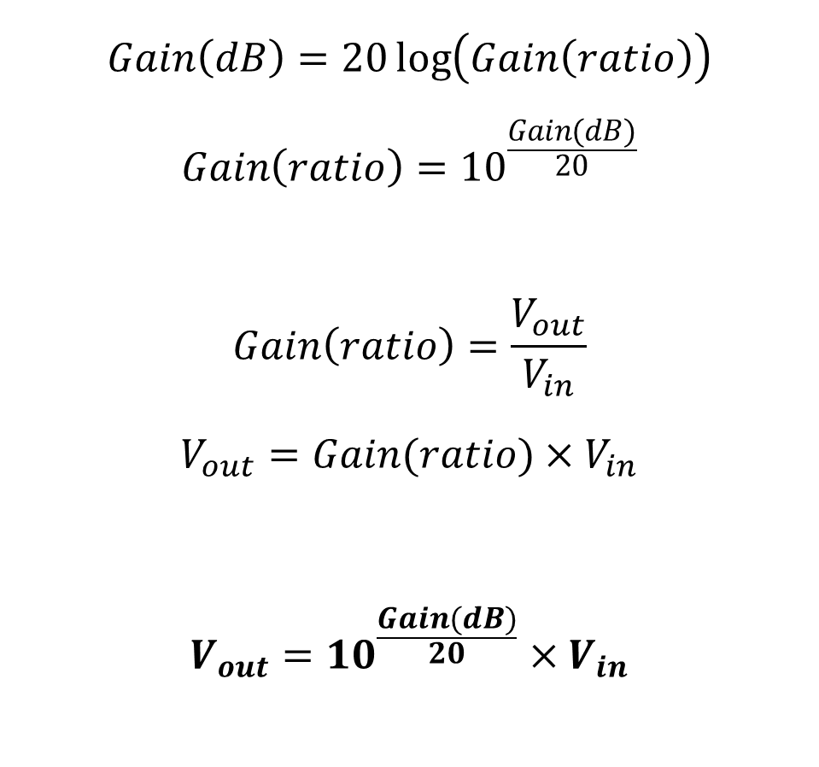
Figure 12.1: Find $V_{out}$ (Recall)
$$Gain\left(dB\right)=20\log\left(Gain\left(ratio\right)\right)$$
$$Gain\left(ratio\right)={10}^{\frac{Gain(dB)}{20}}$$
$$Gain\left(ratio\right)=\frac{V_{out}}{V_{in}}$$
$$V_{out}=Gain(ratio)×V_{in}$$
$$V_{out}={10}^{\frac{Gain(dB)}{20}}×V_{in}$$

Slide 14
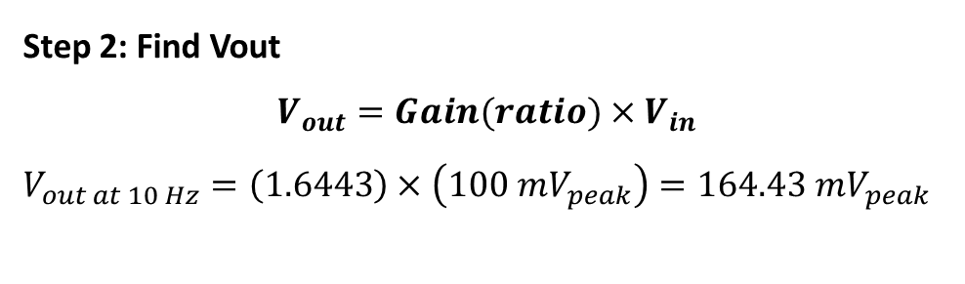

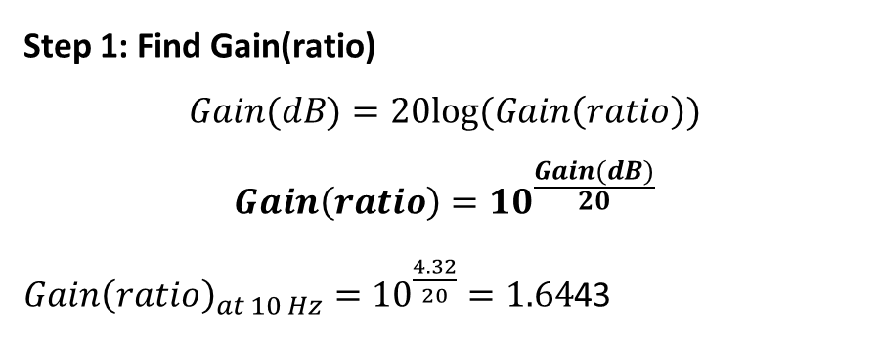

Example: Find $V_{out}$
Given $V_{in}=V_{peak}=100mV$
Frequency (Hz) | Measured Vout (mVpeak) | Gain (dB) | Gain (ratio) | Calculated Vout (mVpeak)
10 |  | 4.32 | 1.6443 | 164.43
Step 1: Find Gain(ratio)
$$Gain(dB)=20log(Gain\left(ratio\right))$$
$$Gain\left(ratio\right)={10}^{\frac{Gain(dB)}{20}}$$
${Gain\left(ratio\right)}_{at 10 Hz}={10}^{\frac{4.32}{20}}=1.64$43
Step 2: Find Vout
$$V_{out}=Gain(ratio)×V_{in}$$
$$V_{out at 10 Hz}=\left(1.6443\right)×\left(100 mV_{peak}\right)=164.43 mV_{peak}$$

Slide 15
Summary
Lab 11 and 12 Report is due Tuesday 20th April 2021 by midnight.
Final Exam will be available from Tuesday 20th April 2021 to Tuesday 27th April 2021.
Fill out Table 11.1, 11.2 and 12.1 with results from…
Simulation
Experimental results

Slide 16
Reference
Electronic Devices and Circuit Theory, 7th Ed. by Robert Boylestad and Louis Nashelsky.

